Slide 1

MSME TAXATION
WHY AND HOW TO REFORM
Rajul Awasthi
Global Tax Team
Acknowledgement:
Michael Engelschalk and
Jan Loeprick
February 2018

Slide 2
WHAT WE WANT TO ACHIEVE TODAY
Understand why reform is important –
      the possibility of promoting a “social contract”
      It’s not just about cost savings for business – its about an efficient and equitable tax system that fosters state building and economic growth
Understand the components of an SME reform
Understand where the risks and difficulties arise in SME reform
Be able to look at your own country/region and think about what reforms might be relevant

Slide 3
PART 1
Why?

Slide 4
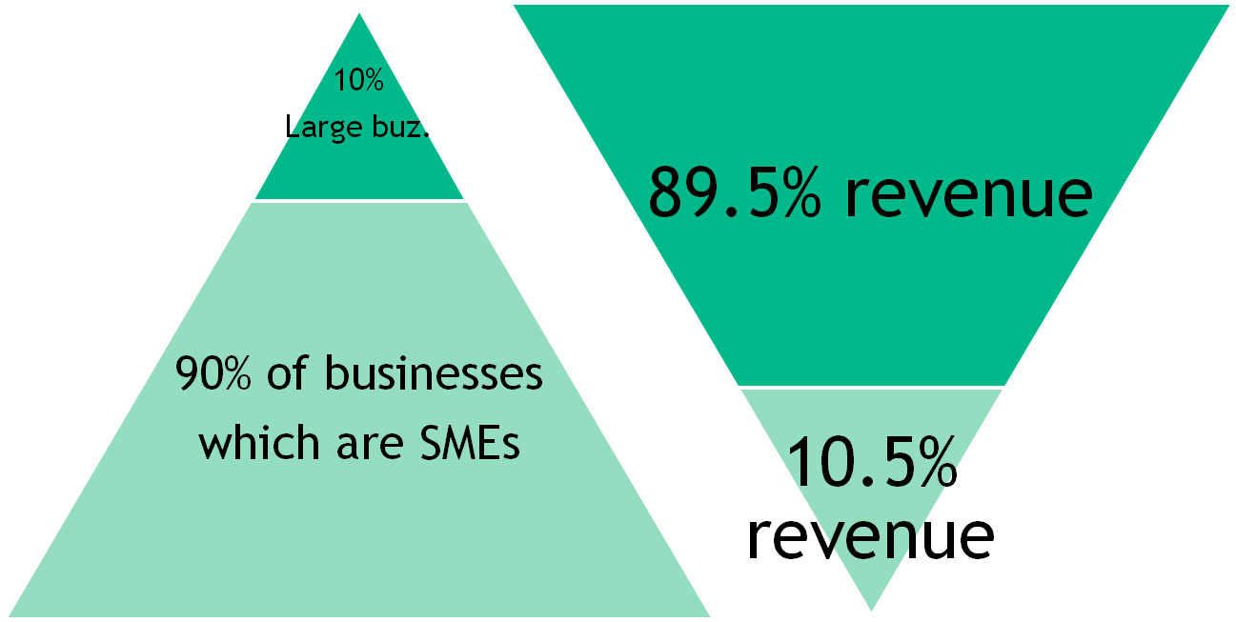
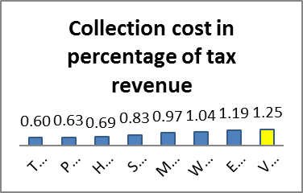
SBT IS BURDENSOME FOR AUTHORITIES AND TAXPAYERS…
  Cost of administering small taxpayers can outweigh short term revenues raised
    ► Small taxpayers neglected — or unproductively harassed
  Example of Vietnam:

Slide 5
SME COMPLIANCE COSTS ARE HIGH – SOUTH AFRICA EXAMPLE
Time and cost estimates for four main taxes:
  Income Tax (IT)
  Provisional Tax (PT)
  Value Added Tax (VAT)
  Employees’ Tax (ET)
Significant processes:
  Registration
  Preparation, completion and submission of returns
  Objections & Alternative Dispute Resolutions (ADR’s)
  Audits, inspections & written queries from tax authority

Slide 6
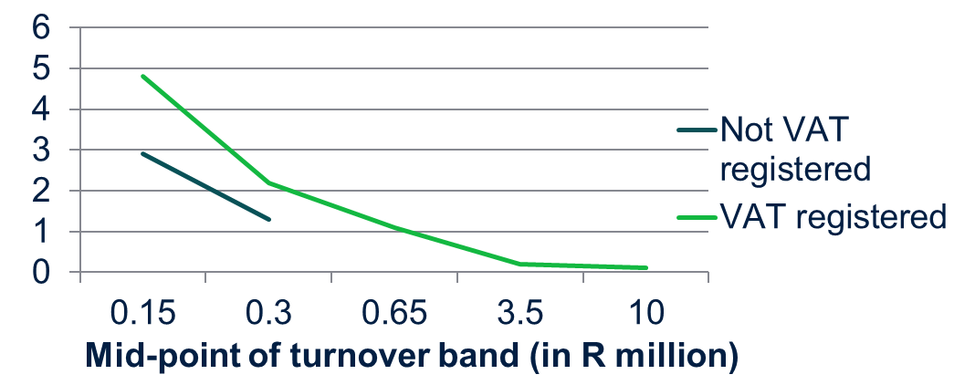
VAT IS A MAIN ELEMENT OF HIGH COMPLIANCE COSTS
Compliance costs as % of turnover for small businesses in South Africa
Source: FIAS, Tax Compliance Burden for Small Businesses: A Survey of Tax Practitioners in South Africa, 2007

Slide 7
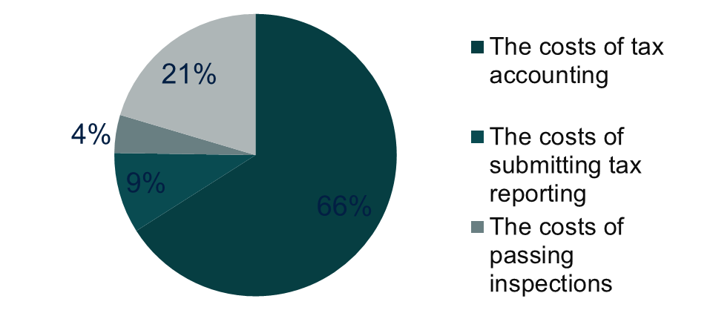
COMPONENTS OF TAX COMPLIANCE COSTS
Results from the compliance cost survey Ukraine 2009

Slide 8
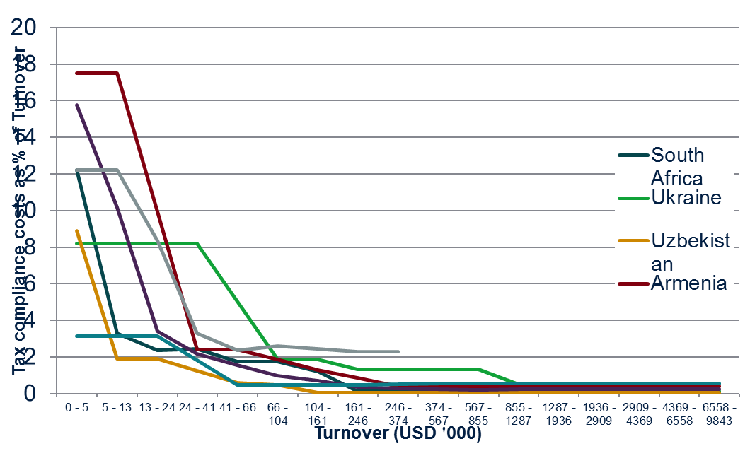
SME? COMPLIANCE COSTS MATTER A LOT FOR MSES!
Source: Tax Compliance Cost Surveys in Selected Countries 2007-1011
Notes:
Question for discussion: When/where is our regulatory work relevant for larger businesses?
Chart is based on compliance cost survey findings in 7 Client countries (surveys conducted between 2007 and 2011).
For the smallest companies the compliance cost can amount to a burden that is equivalent or higher than their actual tax liabilities (> 5% of total turnover).
Pls note: the estimate of the cost of compliance is based on broad assumptions on the value of staff time spend completing tax procedure

Slide 9


WHEN THE “COST OF FORMALIZATION” IS TOO HIGH…
Businesses stay out of the formal economy and can get a “free-ride”
However: more risks, less opportunities (esp. access to finance)
Serious limitations to business growth…
Government is not reaching revenue potential
Spurs vicious cycle of “squeezing” the few compliers => ticket price↗

Slide 10
BUT WHY BOTHER TAXING THEM AT ALL?
If SMEs as a group contribute little to revenue
And compliance costs for SMEs are high
And revenue authorities spend resources on SMEs that could be used elsewhere
Then what’s the point?

Slide 11
Shifting lenses to focus on tax and development
Because tax system participation is important for National Development and Growth Goals:
  The Tax and Development Agenda
  Create a “culture of taxation”
  Promote the “social contract”
  Regularization of the rule of law and legitimacy of the state
  Encourage taxpayers to hold government accountable
  To increase the size of the formal sector
  To promote growth (synergies between tax and development policies)
  Growth ensures higher revenues for government expenditure
Taxing MSEs effectively is “the biggest challenge in state-building”
(Everest-Phillips, 2009)

Slide 12
PART 2:
FROM “WHY?” TO “HOW?”

Slide 13
WHAT EVERYBODY AGREES ON: GENERAL GUIDELINES FOR MSME TAX DESIGN…:
  For small firms, system has to be easy to comply with - minimal compliance costs
  For the authorities, the system must not require excessive administration - ideally based on taxpayer self-assessment and risk based verification by the tax-authority, ...
  Tax system has to encourage growth of business (advantages to graduation)
  Special regimes need to include safeguards against abuses
  Need to distinguish firms which have a lot to gain from becoming formal from subsistence activities (SMEs? – Micro vs. Small vs. Medium)

Slide 14
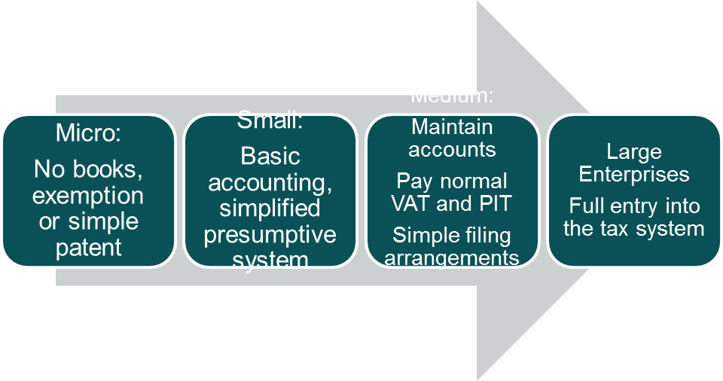
AN IDEAL SME SYSTEM ENCOURAGES GROWTH AND FORMALIZATION
Low compliance cost but doesn’t recognize individual business circumstances
Easy to comply, but no VAT input tax credits
Requires more accounting but offers VAT credits for inputs
Recognizes full circumstances of a larger business

Slide 15
HOW DO WE GET TO THIS IDEAL SYSTEM?
Components of an MSME Reform Package:
Segmentation: Defining micro, small and medium
System design: a special, simplified regime for micro and small taxpayers
Accounting simplification: a separate small business accounting regime
Process simplification: for medium taxpayers
Implementation:
  Regulations
  Training and outreach
  Compliance management
  Monitoring

Slide 16
“MICRO”? “SMALL”? “MEDIUM”?
No single, perfect definition for segmenting taxpayer population
Many possible criteria:
  Income/turnover
  Assets
  Employees
  Business type
Different definitions for different purposes
  Definition often already exists in law – but is it the right one?
  Tax and statistical definitions need not match
For tax, turnover is the key
Specific thresholds are a judgement call

Slide 17
MULTIPLE NON-TAX SME DEFINITIONS ALREADY EXIST
Philippines |  | Min | Max
Assets definition (Magna Carta for Small Enterprises) | Micro |  | P 1,500,000
 | Small | P 1,500,000 | P 15,000,000
 | Medium | P 15,000,000 | P 60,000,000
Indonesia |  | Assets | Turnover
Assets and turnover definition (Law 20/2008) | Micro | Up to IDR 50 m | Up to IDR 300 m
 | Small | 50 - 500 m | 300 m – 2.5 bill
 | Medium | Above 500 m | 2.5 - 50 bill
Vietnam |  | Workers | Assets
Assets and employees definition (Decree 56/2009/ND-CP) | Micro | < 10 | < VND 10 billion
 | Small | 10 - 200 | 10 – 20 billion
 | Medium | 200 - 300 | 20 – 100 billion

Slide 18
SEGMENTATION: MICRO BUSINESSES
Defining the micro business threshold:
  Subsistence level activities
  Link to PIT exemption threshold
  But:
  What are indicators for subsistence level operations?
  PIT exemption threshold: what turnover ratios to be used?
  Impact of a too high / too low threshold

Slide 19
SEGMENTATION: SMALL BUSINESSES
General approach is straightforward: harmonize with VAT registration threshold. BUT:
  - Does not take into account different average profit margins in different small business sectors
  - Traders are moved to the standard regime more quickly than service businesses
Issues arise when VAT system does not have a threshold (Vietnam) or has a very high threshold (Armenia):
  How to determine a VAT threshold?
  Increasing incentives for abuse of simplified regime by larger businesses?

Slide 20
SIMPLIFYING THE REGIME
Problem: small businesses are out of their depth in the normal regime:
Income tax normally taxes profits
  But many small businesses don’t separate business income/expenses from household income/expenses
Value Added Tax systems require complex accounting:
    Maintaining invoices
    Tracking supplies and inventories
  But small businesses tend to work on a cash basis; micro businesses often have no records at all

Slide 21
SOLUTION: MATCH THE SYSTEM TO TAXPAYER CAPACITY
Simplifying the Regime:
Small taxpayers: use a more easily measured substitute for profit: Turnover
  “Presumptive regime”: presumes taxpayers are making a profit and a low turnover tax is equivalent to normal tax on their profits.
Micro taxpayers: assume no books at all and exempt or levy a small annual fee (patent)
  Why is micro regime design important? Issue is not revenues, but (i) associating micros with tax system, and (ii) counteracting abuse

Slide 22
BUT THE DEVIL IS IN THE DETAIL!
How to avoid over - and under - taxation of SMEs?
  Simplicity versus accuracy: multiple presumptive rates or only one or two? Are we penalising loss-makers?
How to avoid abuse of system by larger businesses?
  Avoid creating incentives to split up and hide in the small regime.
How to treat businesses that don’t keep books and records
  ► Requires a “fallback” system of indicators in addition to the standard turnover system
How to align the SME regime with the standard tax regime?
  What happens to businesses with turnover near the threshold?
System must be perceived as fair and transparent
  Avoid opportunities for tax officers to negotiate on assessments.
How to provide incentives for keeping proper books and records?
  Or at least avoid disincentive to keep books!

Slide 23
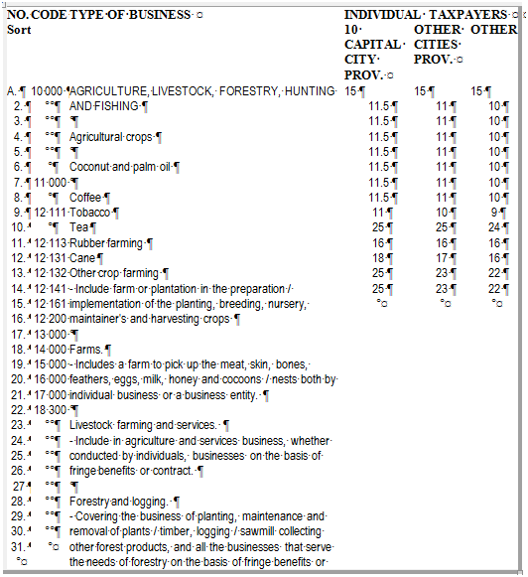
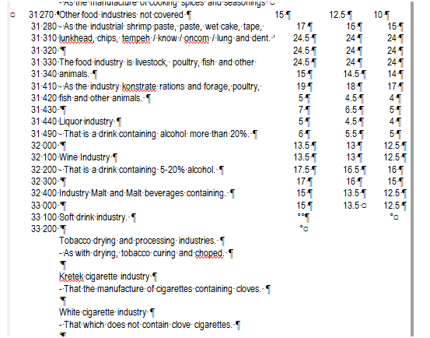
EXAMPLE: TOO MANY PRESUMPTIVE RATES - INDONESIA
KEP-536/PJ.2/2000 – “Norms for the calculation of net income taxpayers” covers more than 150 categories, including:

Slide 24
A SMALL NUMBER OF RATES IS SIMPLE
But does it sufficiently take into account the country range of businesses and urban vs rural??
Small business segment | Tax rate
Trade | Around 2% of turnover
Service sector | Around 6% of turnover
Other small businesses | Around 4% of turnover

Slide 25
“FALL-BACK INDICATORS” ARE TRICKY TO WORK WITH
Example: Yemen
“With regard to the taxpayers who do not hold the required books, […] annual business turnover determined on the basis of the nature and the volume of the activity and the the following indicators, where applicable and where the information is available:
  Area of the headquarters of the establishment and number of the branches;
  The geographical location of the establishment;
  Value of the fixed assets;
  The monthly rental value of the establishment and its branches, and in case the real estate is utilized by the same owner, then the type of the real estate and the estimated rental value shall be determined compared to similar cases;
  Value of the utilized power supply for the purposes of the activity;
  The establishment transactions with third parties;
  Data available with the tax administration;
  Outcomes of the discussions with and inspection of the establishment carried out by the tax officer;
  Number of the personnel working in the establishment; and
  Any other indicators to be identified by guidelines to be issued by the Chairman of the Authority.”
Can subjective judgement be avoided? Don’t create an incentive not to keep accounts!

Slide 26
ACCOUNT KEEPING INCENTIVES ARE DIFFICULT TO DESIGN
Tanzania: progessive system from 1.1% to 3.3% of turnover with higher tax burden for businesses not keeping sufficient books and records.
But: Expected increase in number of businesses keeping cash books not achieved. Currently reviewing system.

Slide 27
ACCOUNTING
No successful small business tax reform without simplification of the accounting regime
  Accrual-based accounting standards often required in our client countries
Dealing with the right counterpart: tax accounting vs general accounting rules reform
The IFRS for SMEs developed by the IASB: more of an obstacle than a support tool for our work?
Need guidelines for the operation of a cash accounting system appropriate for turnover based presumptive taxation

Slide 28
SIMPLIFICATION FOR MEDIUM TAXPAYERS
Ample good practice available from OECD countries
  Reducing filing frequency
  Reducing payment frequency
  Simplifying reporting requirements
Issues with simplification:
  Uncertainty about setting the right threshold
  Concerns about revenue implications
  Concerns about reduced data availability
In some cases our work should not be about simplifying, but rather complicating reporting requirements…! i.e., more data and information to be reported with returns

Slide 29
IMPLEMENTING REGULATION/ TRAINING AND OUTREACH
Implementing Regulations: Crucial!!!
  The tax law is only the first step
  Without carefully designed implementing regulations all the old problems can return
  Must be enough detail to avoid ambiguity and subjective negotiations between taxpayer and tax officials
Designing a tax return form: solving the conflict between simplicity and data collection desire.
Training and outreach
  Development of guidelines and training material for tax administration staff training
  Partner with private sector (and with tax administration) for reaching out to SMEs

Slide 30
COMPLIANCE MANAGEMENT (I)
Setting the right priorities:
Improved tax policy design does not automatically translate into broadening the tax net (and neither does reducing tax rates)
Need to consider simple registration and even incentives:
  Simplification of the overall business registration process as first important step
  Less clarity regarding further incentives to formalize
  Can we link tax registration to better access to finance or access to special small business management?

Slide 31
COMPLIANCE MANAGEMENT (II)
A balance between service and enforcement:
Link SME work stream to audit reform:
  A Risk-Based Audit system complements the SME work stream
Revising penalty regimes as an indicator for willingness to change compliance management? In reality an easy but unpopular reform step!

Slide 32
WHAT DO WE NEED TO KNOW IN ORDER TO REFORM?
Data is key to developing reforms – and demonstrating our results
Cannot design an appropriate SME system without understanding local SME characteristics
How do we gather this information?
  Tax authority data – but with low compliance, frequently very incomplete
  Statistical agencies – but data is often old or doesn’t exist
Often we are forced to find it for ourselves: undertake in-country SME surveys

Slide 33
DATA THAT WE NEED:
Tax Authorities:
  Number of registrations
  Numbers of returns
  Number of returns amended
  Numbers of audits
  Revenue
  Tax authority costs
SME Surveys:
  Compliance costs
  Tax system perceptions
  Characteristics of the SME population
  Estimates of turnover
  Data on fall-back indicators

Slide 34
A TYPICAL SME SURVEY:
GEORGIA: TAX COMPLIANCE COST SURVEY OF MSMES
Survey of Micro, Small and Medium Enterprises Conducted in October-December 2010
  820 active firms surveyed face-to-face:
    323 micro (gross annual revenue<30,000 GEL, according to RS database), more than half (54%) with a single person working – possibly qualify for micro-firm status
    303 small (30,000 GEL <= gross annual revenue < 100,000 GEL)
    194 medium (100,000 GEL <= gross annual revenue < 500,000 GEL)
  Reference period: 2009
  Sample Frames derived from Revenue Service and GeoStat databases
  Stratified (by size, sector and region) random sampling design

Slide 35
MAJOR RESEARCH QUESTIONS
What are the expenses of enterprises to comply with tax regulations?
  Labor costs
    Tax accounting (filing & paying taxes, finding & analysis of legislation, preparation of additional information upon the request of tax authorities)
    Tax inspections
    Visits to tax authorities offices
  Monetary costs
    Outsourcing of tax accounting services
    Penalties & fines (cost for non-compliance)
    Various other expenses (software, hardware, stationery)
What are the perceptions regarding Georgian taxation system?

Slide 36
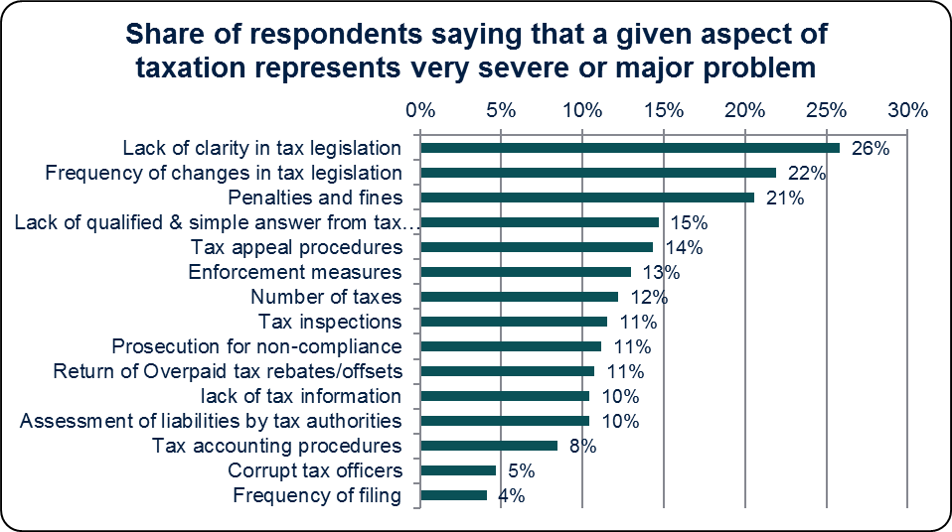
RESPONSES HELP IN DESIGNING THE INTERVENTION:
MAJOR TAX-RELATED PROBLEMS FOR RESPONDENTS ARE LACK OF CLARITY AND FREQUENCY OF CHANGES IN TAX LEGISLATION, AS WELL AS PENALTIES
Notes:
Sample sizes: varies from 517 to 813 (all respondents, except “don’t know” and missing answers) – from sheet “12-13_%_probl”.

Slide 37
AND GIVE AN IDEA OF ACTUAL REVENUES:
EIGHTY PERCENT OF RESPONDENTS REPORTED ANNUAL REVENUE IN THE SAME RANGE AS IN THEIR TAX RETURNS
Self-reported revenue in TCCS (GEL) | Annual Revenue According to RS |  |  | Total
 | R < 30,000 GEL | 30,000 <= R < 100,000 | 100,000 <= R < 500,000
R < 30,000 GEL | 253 | 80 | 18 | 351
30,000 <= R < 100,000 | 9 | 185 | 19 | 213
100,000 <= R < 500,000 | 4 | 4 | 126 | 134
R > 500,000 | 2 | 1 | 3 | 6
Total | 268 | 270 | 166 | 704
Revenue reported in TCCS in the same range as in tax returns | 564 | 80.1%
Revenue underreported in TCCS | 117 | 16.6%
Revenue overreported in TCCS | 23 | 3.3%
Notes:
Sheet “62”

Slide 38
APPROACHES TO REFORM WILL DEPEND ON VARIOUS FACTORS…
The capacity of the state/ tax administrations: Administrative resources and efficiency?
Capacity of MSEs: Numeracy, literacy and accounting practices?
Differing policy goals (equity vs. efficiency, redistribution, formalization vs. better business practices…), legal traditions, …?
Is there a pattern of appropriate regimes for different stages of institutional development?

Slide 39
THE BASIC BUILDING BLOCKS OF MSME TAX REFORM
Segmentation of taxpayers
Tax administration training
Designing simplified tax regimes
MSME tax reform
MSME compliance management
Implementing rules and regulations
Taxpayer outreach and communications
Accounting simplification

Slide 40
MAIN LESSONS LEARNED
Ministries of Finance generally are pushing MSME tax reforms much more than tax administrations. But tax administration management needs to be involved early in the reform process.
System abuse by larger businesses is major problem in many client countries. Need policy and administrative countermeasures.
Lack of reliable data considerably complicates fallback indicator design. More research and analysis early in the system design process necessary.
Refining good practice examples is required: not only how have other countries done it, but also why have they done it in a particular way.
Refining approach to estimating turnover based on indicators and profit margins based on turnover
Developing guidelines for MSME tax accounting design

Slide 41
Thank you!
rawasthi@worldbank.org

